Slide 1
MATRIX OPERATIONS AND PROPERTIES
MATH 15 - Linear Algebra

Slide 2
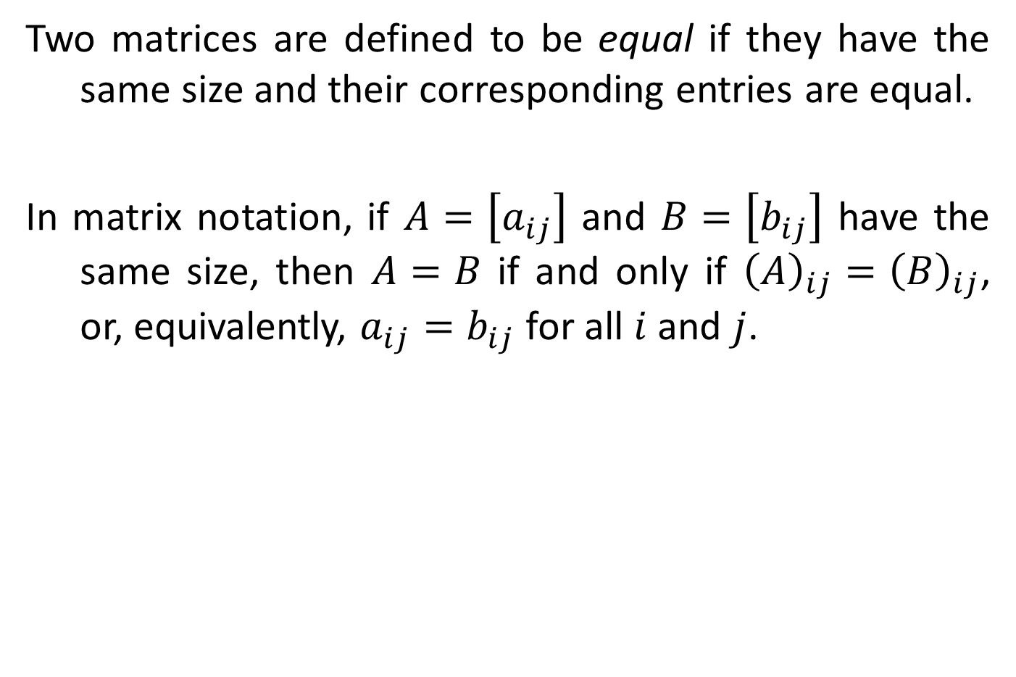
DEFINITION
Two matrices are defined to be equal if they have the same size and their corresponding entries are equal.
In matrix notation, if $A=\left[a_{ij}\right]$ and $B=\left[b_{ij}\right]$ have the same size, then $A=B$ if and only if ${\left(A\right)}_{ij}={\left(B\right)}_{ij}$, or, equivalently, $a_{ij}=b_{ij}$ for all $i$ and $j$.

Slide 3
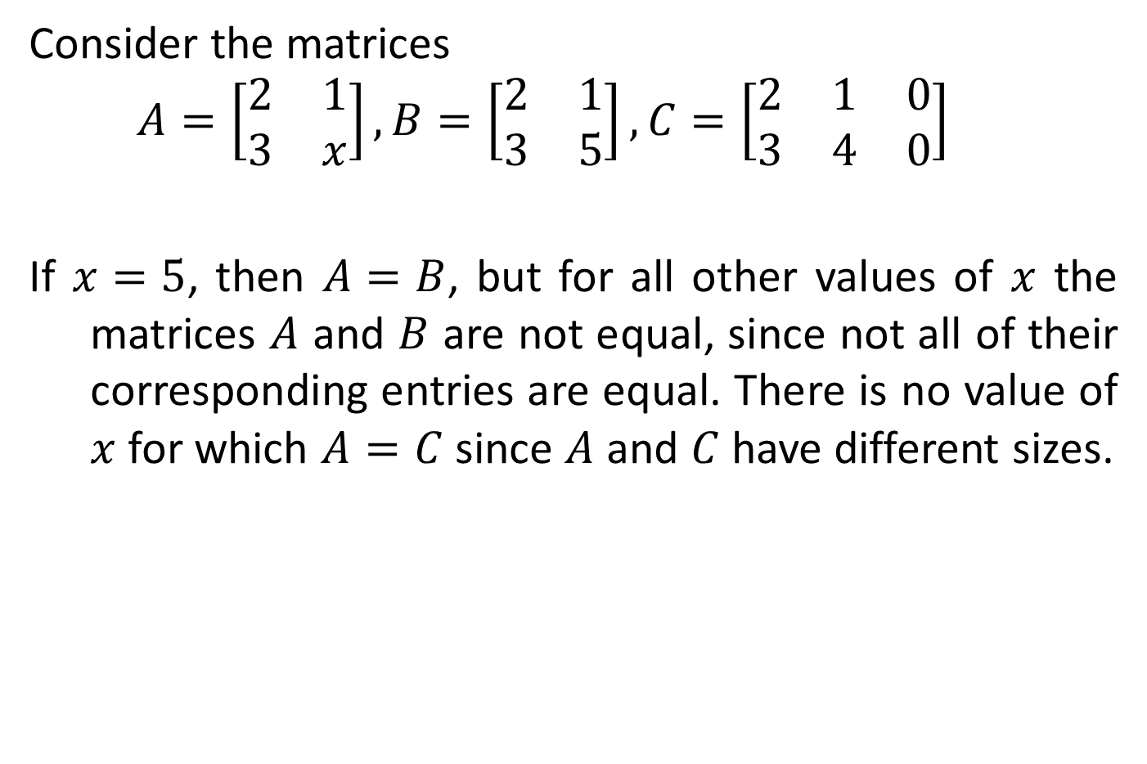
EQUALITY OF MATRICES
Consider the matrices
$$A=\left[\begin{matrix}2 & 1 \\ 3 & x\end{matrix}\right], B=\left[\begin{matrix}2 & 1 \\ 3 & 5\end{matrix}\right], C=\left[\begin{matrix}2 & 1 & 0 \\ 3 & 4 & 0\end{matrix}\right]$$
If $x=5$, then $A=B$, but for all other values of $x$ the matrices $A$ and $B$ are not equal, since not all of their corresponding entries are equal. There is no value of $x$ for which $A=C$ since $A$ and $C$ have different sizes.

Slide 4
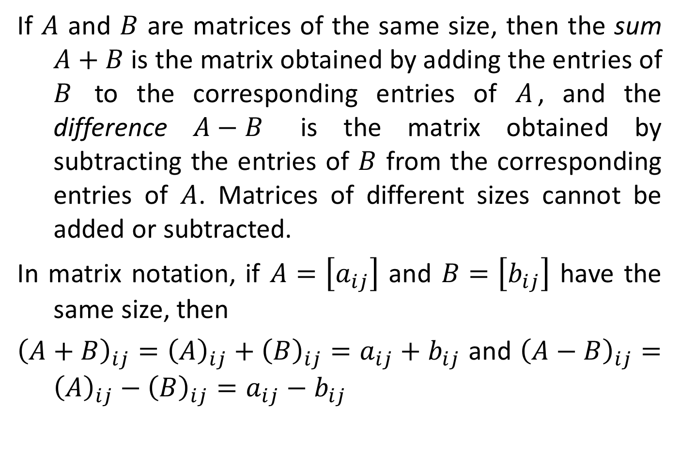
DEFINITION
If $A$ and $B$ are matrices of the same size, then the sum $A+B$ is the matrix obtained by adding the entries of $B$ to the corresponding entries of $A$, and the difference $A−B$ is the matrix obtained by subtracting the entries of $B$ from the corresponding entries of $A$. Matrices of different sizes cannot be added or subtracted.
In matrix notation, if $A=\left[a_{ij}\right]$ and $B=\left[b_{ij}\right]$ have the same size, then
${\left(A+B\right)}_{ij}={\left(A\right)}_{ij}+{\left(B\right)}_{ij}=a_{ij}+b_{ij}$ and ${\left(A−B\right)}_{ij}={\left(A\right)}_{ij}−{\left(B\right)}_{ij}=a_{ij}−b_{ij}$

Slide 5

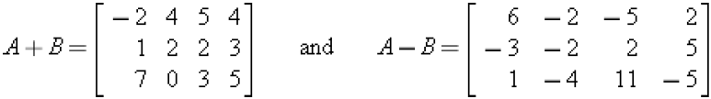

ADDITION AND SUBTRACTION
Consider the matrices
then
The expressions $A+C$, $B+C$, $A−C$, and $B−C$ are undefined.

Slide 6
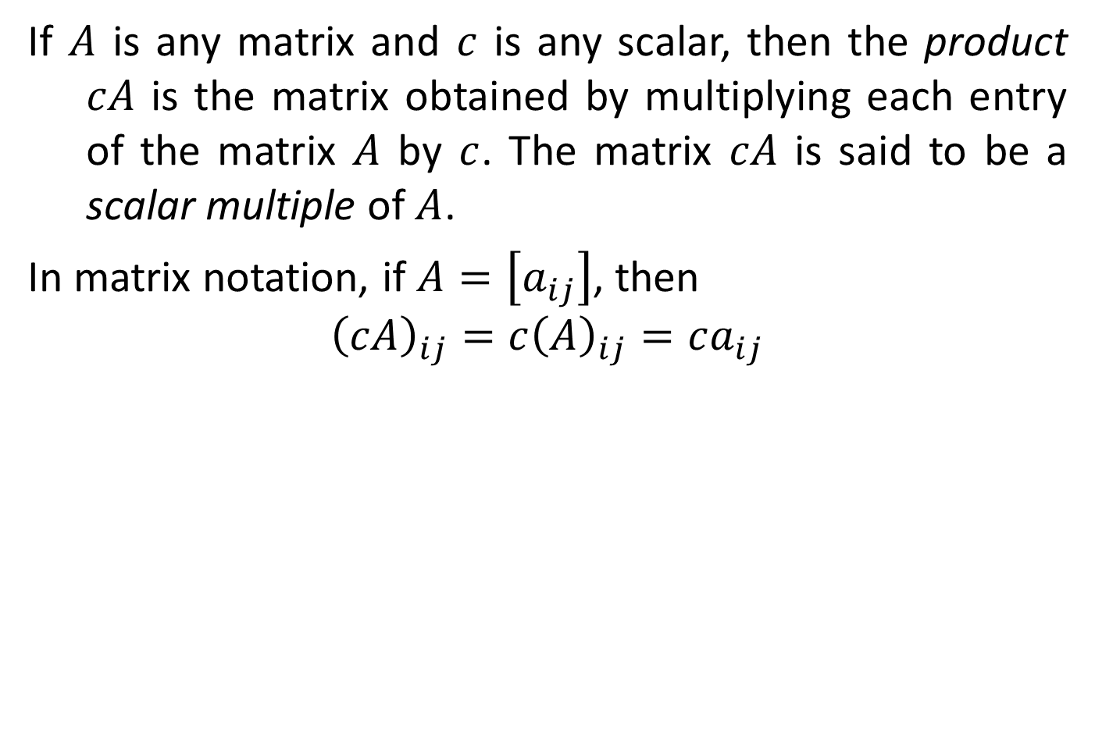
DEFINITION
If $A$ is any matrix and $c$ is any scalar, then the product $cA$ is the matrix obtained by multiplying each entry of the matrix $A$ by $c$. The matrix $cA$ is said to be a scalar multiple of $A$.
In matrix notation, if $A=\left[a_{ij}\right]$, then
$${\left(cA\right)}_{ij}=c{\left(A\right)}_{ij}=ca_{ij}$$

Slide 7

SCALAR MULTIPLES
For the matrices
we have
It is a common practice to denote $\left(−1\right)B$ by $−B$.

Slide 8
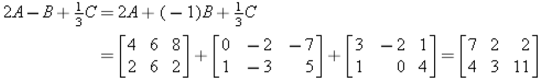
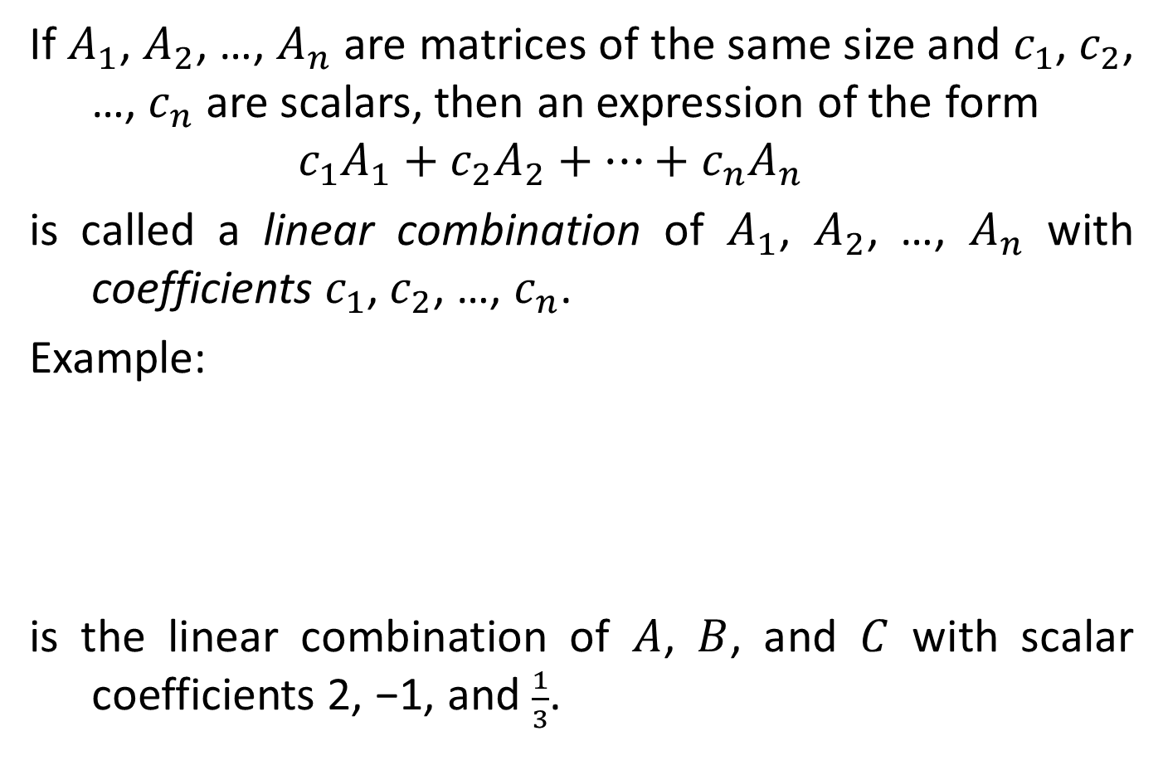
DEFINITION
If $A_{1}$, $A_{2}$, …, $A_{n}$ are matrices of the same size and $c_{1}$, $c_{2}$, …, $c_{n}$ are scalars, then an expression of the form
$$c_{1}A_{1}+c_{2}A_{2}+⋯+c_{n}A_{n}$$
is called a linear combination of $A_{1}$, $A_{2}$, …, $A_{n}$ with coefficients $c_{1}$, $c_{2}$, …, $c_{n}$.
Example:
is the linear combination of $A$, $B$, and $C$ with scalar coefficients 2, −1, and $\frac{1}{3}$.

Slide 9
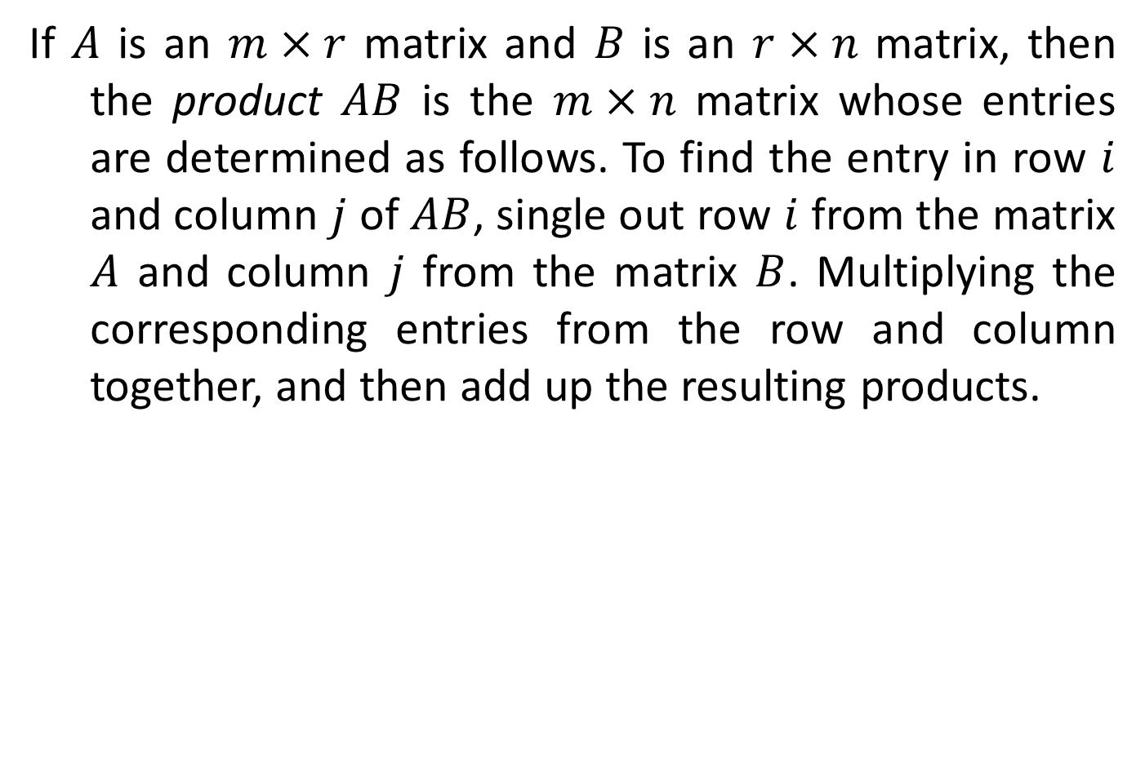
DEFINITION
If $A$ is an $m×r$ matrix and $B$ is an $r×n$ matrix, then the product $AB$ is the $m×n$ matrix whose entries are determined as follows. To find the entry in row $i$ and column $j$ of $AB$, single out row $i$ from the matrix $A$ and column $j$ from the matrix $B$. Multiplying the corresponding entries from the row and column together, and then add up the resulting products.

Slide 10
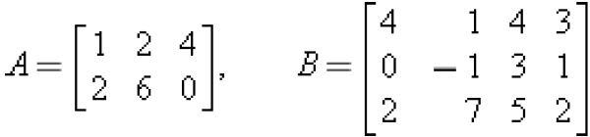
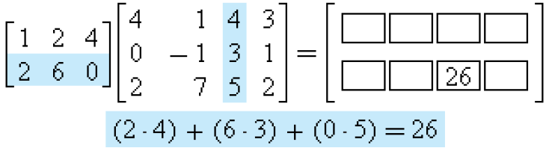
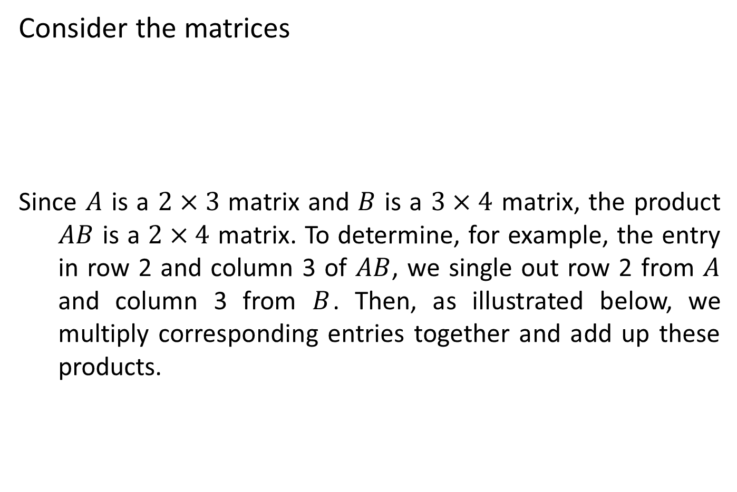
MULTIPLYING MATRICES
Consider the matrices
Since $A$ is a $2×3$ matrix and $B$ is a $3×4$ matrix, the product $AB$ is a $2×4$ matrix. To determine, for example, the entry in row 2 and column 3 of $AB$, we single out row 2 from $A$ and column 3 from $B$. Then, as illustrated below, we multiply corresponding entries together and add up these products.

Slide 11
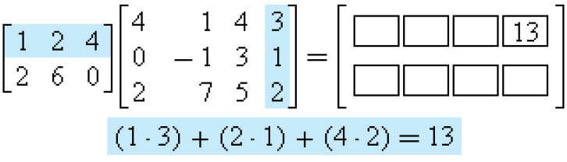
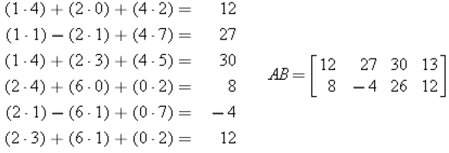

MULTIPLYING MATRICES
The entry in row 1 and column 4 of $AB$ is computed as follows:
The computations for the remaining entries are

Slide 12
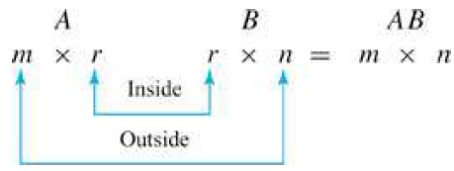
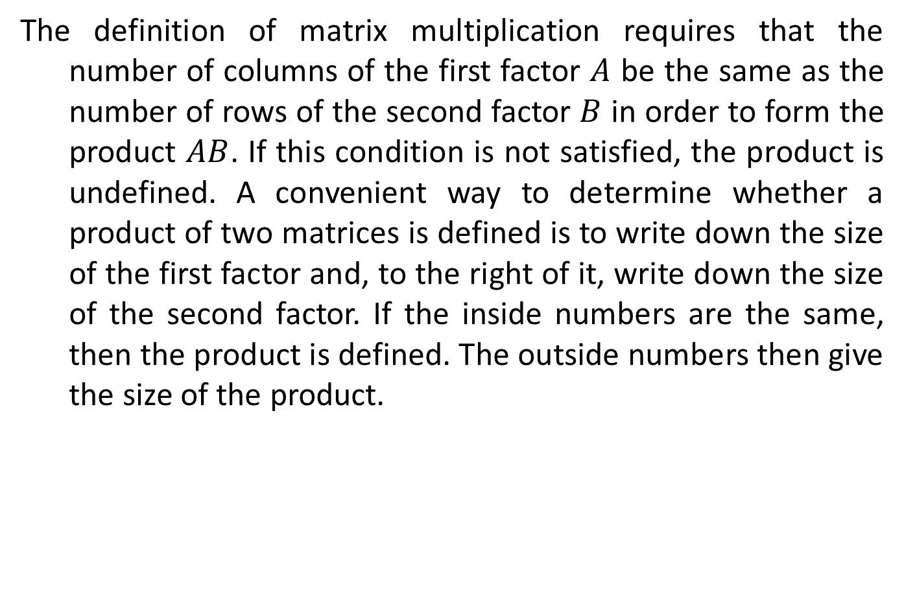
MULTIPLYING MATRICES
The definition of matrix multiplication requires that the number of columns of the first factor $A$ be the same as the number of rows of the second factor $B$ in order to form the product $AB$. If this condition is not satisfied, the product is undefined. A convenient way to determine whether a product of two matrices is defined is to write down the size of the first factor and, to the right of it, write down the size of the second factor. If the inside numbers are the same, then the product is defined. The outside numbers then give the size of the product.

Slide 13

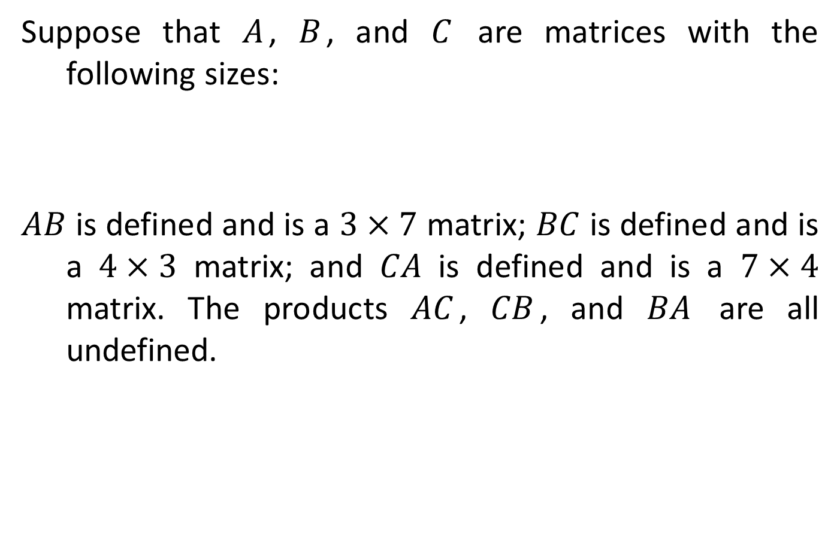
Determining Whether a Product is Defined
Suppose that $A$, $B$, and $C$ are matrices with the following sizes:
$AB$ is defined and is a $3×7$ matrix; $BC$ is defined and is a $4×3$ matrix; and $CA$ is defined and is a $7×4$ matrix. The products $AC$, $CB$, and $BA$ are all undefined.

Slide 14
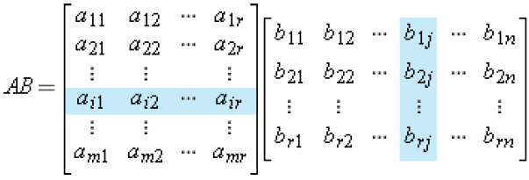
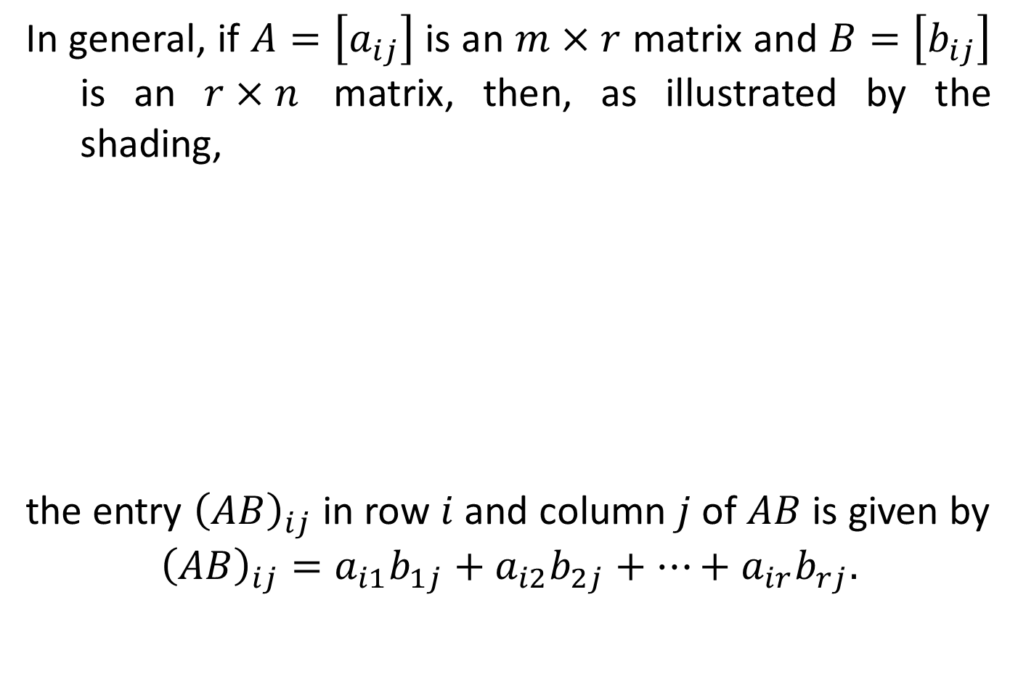
Determining Whether a Product is Defined
In general, if $A=\left[a_{ij}\right]$ is an $m×r$ matrix and $B=\left[b_{ij}\right]$ is an $r×n$ matrix, then, as illustrated by the shading,
the entry ${\left(AB\right)}_{ij}$ in row $i$ and column $j$ of $AB$ is given by
$${\left(AB\right)}_{ij}=a_{i1}b_{1j}+a_{i2}b_{2j}+⋯+a_{ir}b_{rj}.$$

